Slide 1

Integrating price dynamics and POI to the Schelling model
Benjamin Gramsch
Johanna Ribas
Jonas Tam
Supervised by:
Prof. Dirk Helbing
Dr. Dino Carpentras
Dr. Damian Dailisan
12.10.2023
Complex Social Systems: Modelling Agents, Learning, and Games

Slide 2
Outline
Introduction
Related work
Model description
Results
Discussion

Slide 3
Introduction
Urbanization and international mobility has amplify social segregation (Harvey, 2008)
Segregation has negative impacts on the social structure, economic opportunities, and the overall distribution of resources within communities (Dadashpoor, 2019)
The first studies of segregation started in 1920s with the work of the Chicago School of Sociology
Schelling was the first person to model segregation generated by individuals interacting
Notes:
Globalization has brought substantial changes in urban structures, increasing the competition for social and economic capital and reshaping the demographic composition of cities due to new demands for labor force \cite{musterd_urban_2020}; this new dynamics of intercity mobility, in combination with increasing market competition, has generated the displacement of low-income individuals, amplifying social segregation \cite{harvey_right_2008}. This segregation significantly influences the social structure, economic opportunities, and the overall distribution of resources within communities \cite{adelman_racial_2007, dadashpoor_exploring_2019, shihadeh_segregation_1996}.
Segregation has negative impacts on the social structure, economic opportunities, and the overall distribution of resources within communities
The first studies of social segregation were conducted by the Chicago School of Sociology, which proposed three stages of immigration residential choice and the integration of these communities into urban life. The first stage was the \emph{inner-city ghetto}, in which immigrant communities tend to live in impoverished areas, spatially separated from other groups, the \emph{upward mobility}, in which these groups start integrating into the urban life as part of the workforce, until the final phase which is \emph{dispersal}, in which this group was fully integrated into the city \cite{vaughan_challenges_2011}. However, it was not until the work of \cite{schelling_models_1969} that the segregation dynamics were modeled, which created the base for understanding how local interactions among agents can lead to global patterns of spatial segregation. This model is considered one of the first applications of agent-based models in social sciences and shows the dynamics of self-organization in the housing market and how mild preferences for neighbors of similar characteristics can generate entirely segregated neighborhoods.

Slide 4
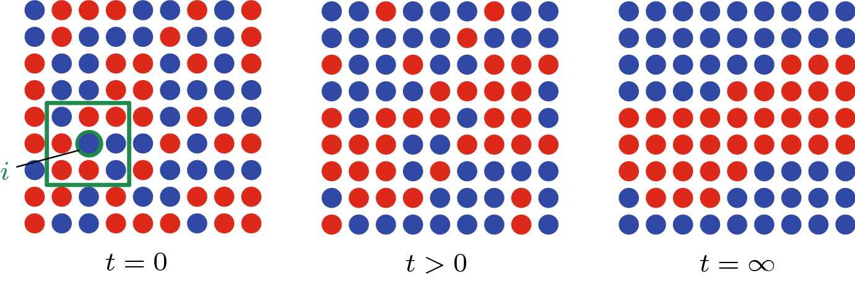
Introduction
The Schelling model was published in 1971
There are two types of agents: Blacks and Whites
Each agent wants to be with similar neighbours and move accordingly
The model showed that a preference for homogeneous neighbours can generate segregation
Source: Holden & Sheffield 2020
Notes:
The Schelling model is considered the first agent based model in social sciences

Slide 5
Related work
The literature has implemented new versions of the Schelling model
Heterogeneous agents can generate patterns of segregation-integration (Hatna & Benenson, 2012) and reduce segregation (Xie, 2012)
Heterogeneous groups generate a core segregated neighbour of the bigger group and a periphery of the smaller group (Benenson, 2011)
Integrating random agents generate more agent satisfaction and more segregation (Bruch, 2006)
We integrated two variables into the model: Dynamic pricing and Points-of-Interest. Our interest is to replicate agglomeration effects generated by cities.
Notes:
The technological advancement has helped researchers to make the model more complex

Slide 6


Model Description
Agent’s attributes:
Agent type
Wealth
Satisfaction threshold
Interest in each type of amenity
Spatial attributes:
Cell type (amenities)
Cell price

Slide 7
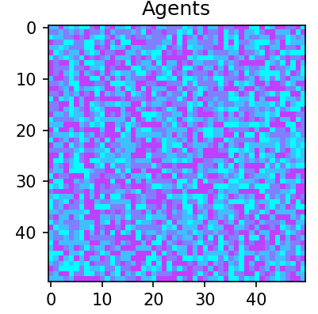
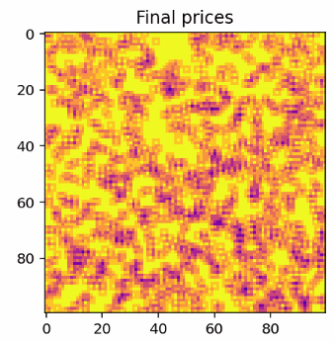
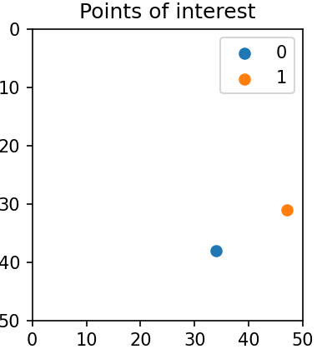
Model Description
Agent types
Cell prices
Special amenities
High population density
High cell price

Slide 8
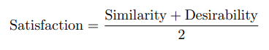

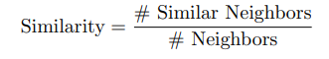
Model Description
Agents satisfaction increases when they live surrounded by agents of the same type and close to their preferred amenities.

Slide 9


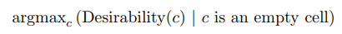
Model Description
For each agent at each location, IF:
Satisfaction < Threshold OR Wealth < Price
Agent moves to a new cell:

Slide 10
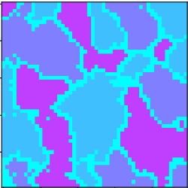
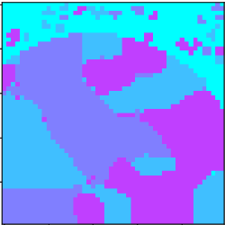
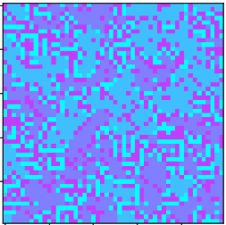
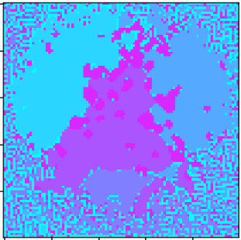
Results - Strategies
Random Move strategy
Minimum Distance strategy
Dynamic Price strategy
Combined Model

Slide 11
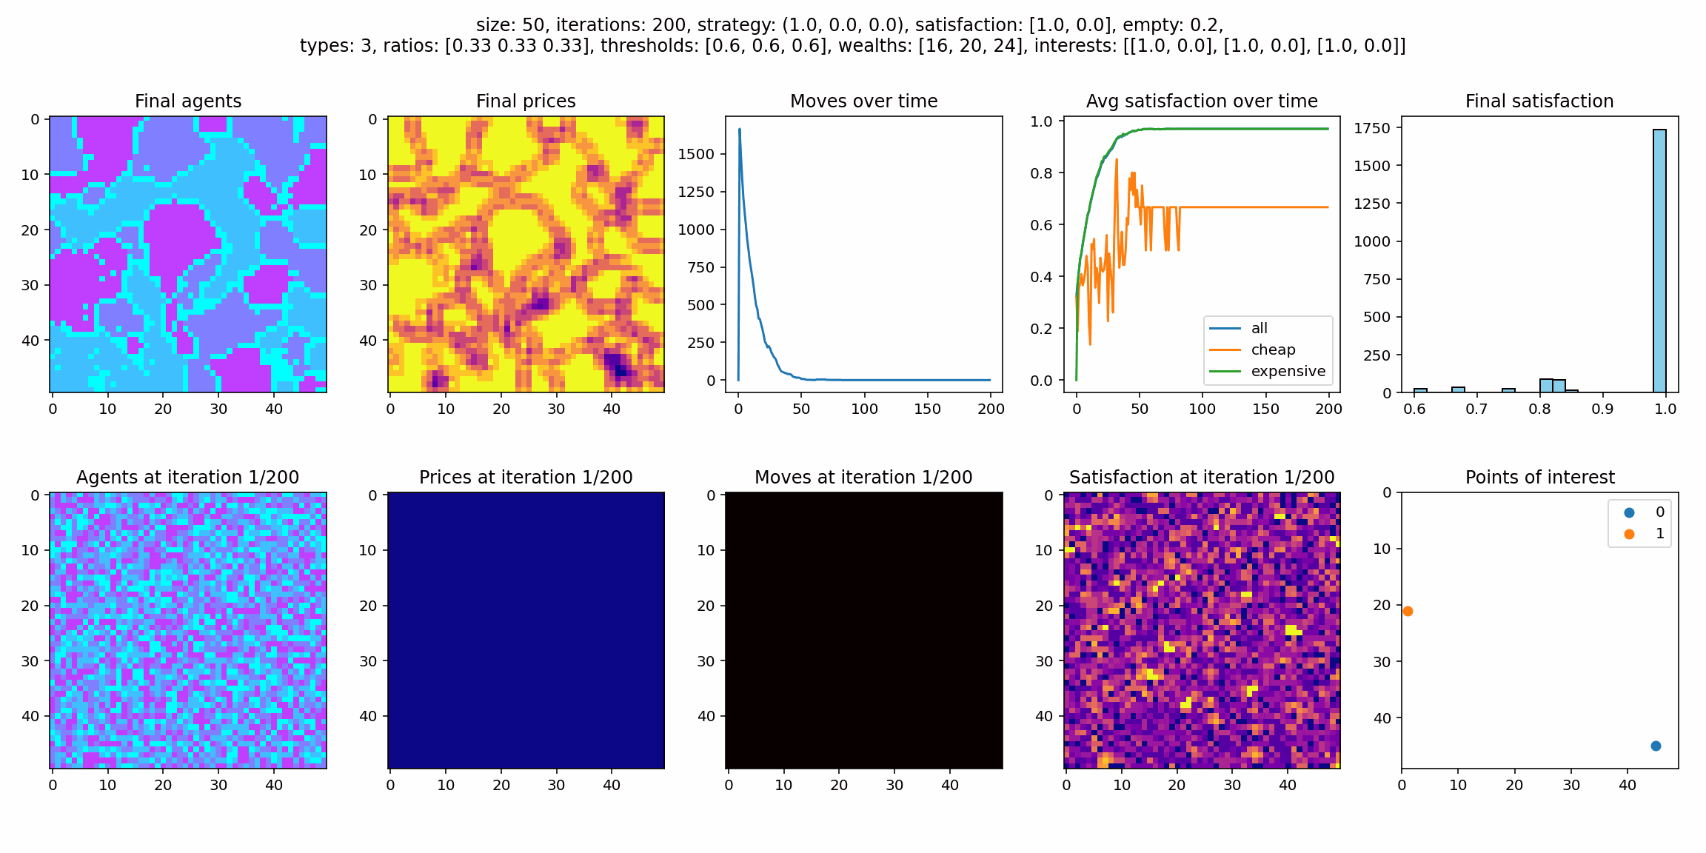
Results - Stable Example
Once the model converges on a stable state, there is no more movement since all agents are satisfied

Slide 12
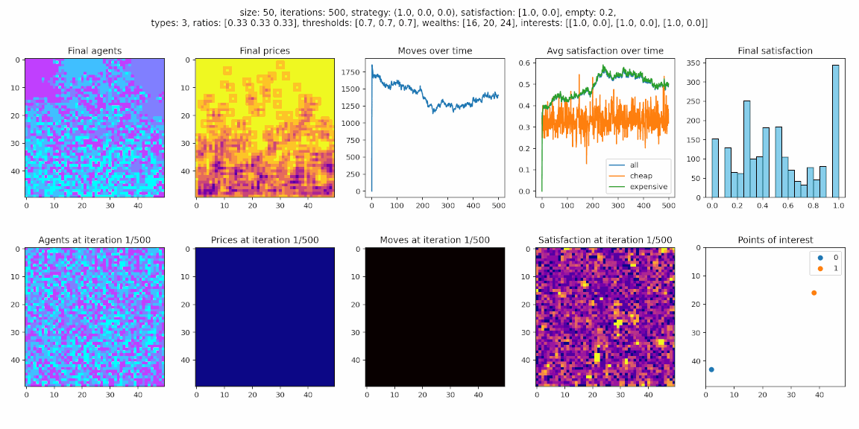
Results - Unstable Example
Agents do not reach their satisfaction threshold and keep moving indefinitely

Slide 13
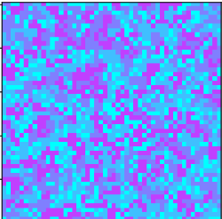
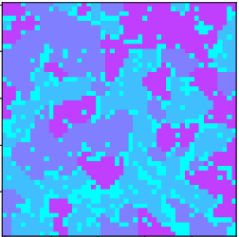
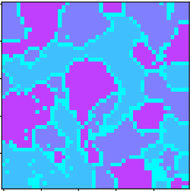
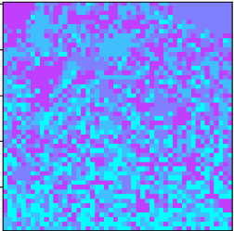
Results - Threshold Ranges
0.2
0.4
0.6
0.8
Threshold values between 0.30 and 0.66 consistently result in stable segregation

Slide 14
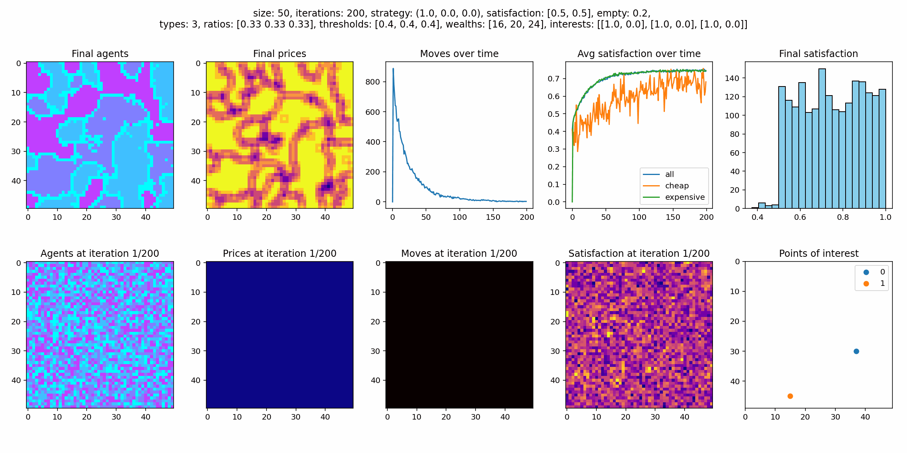
Results - Random Strategy with Noise
Including cell desirability in agent satisfaction introduces noise

Slide 15
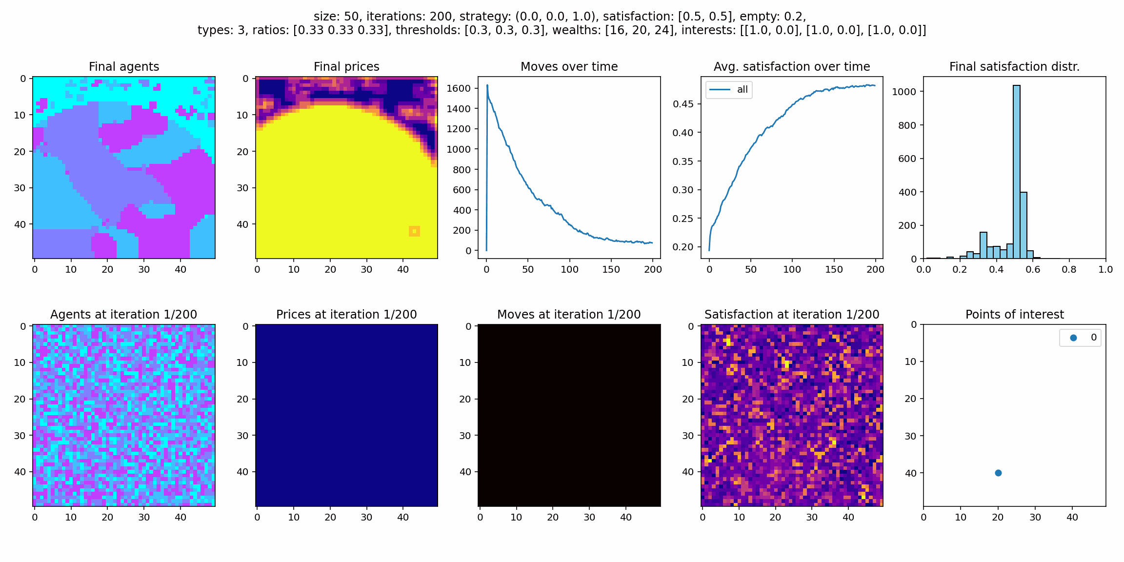
Results - Distance Strategy
Agents only care about distance to point 0 and form a perfect circle

Slide 16
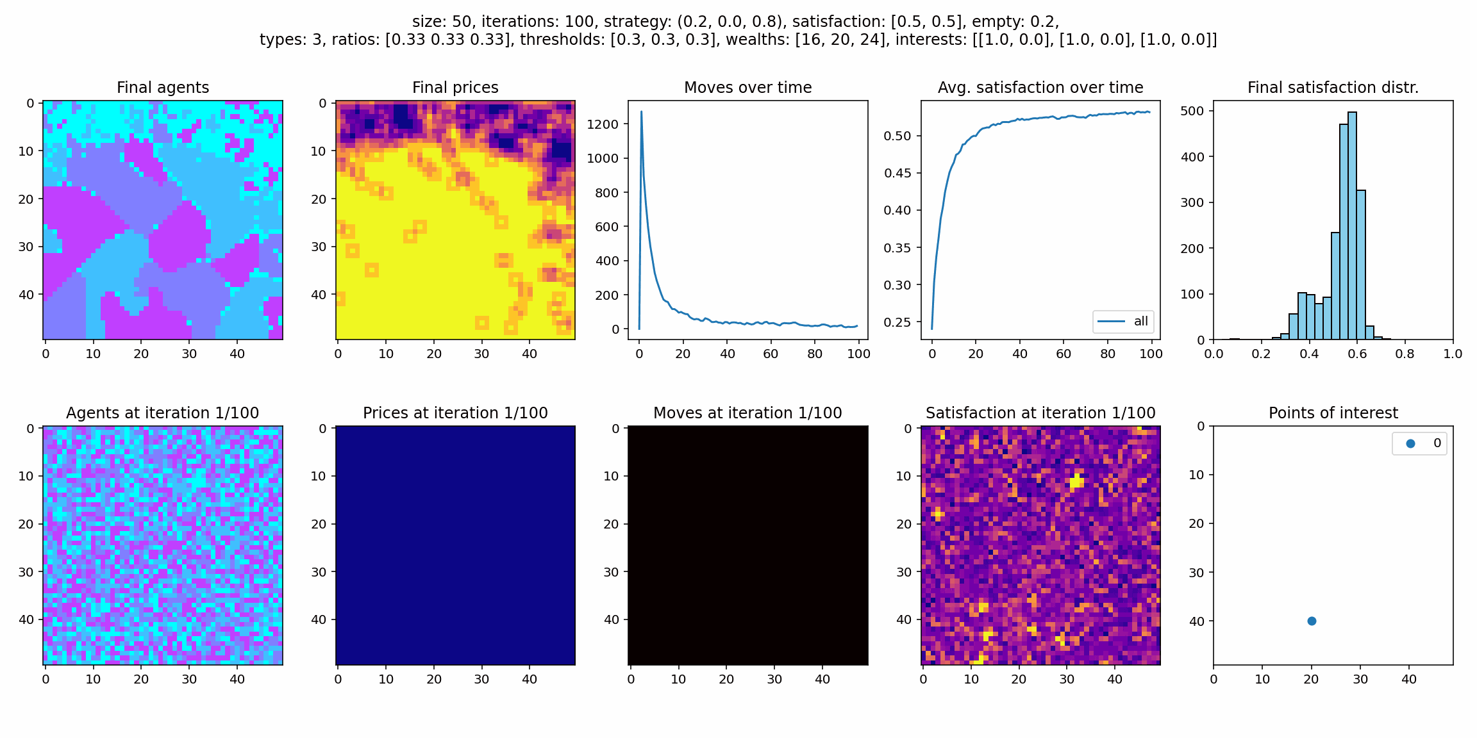
Results - Distance with Noise
Also including the random strategy component creates more natural behavior

Slide 17
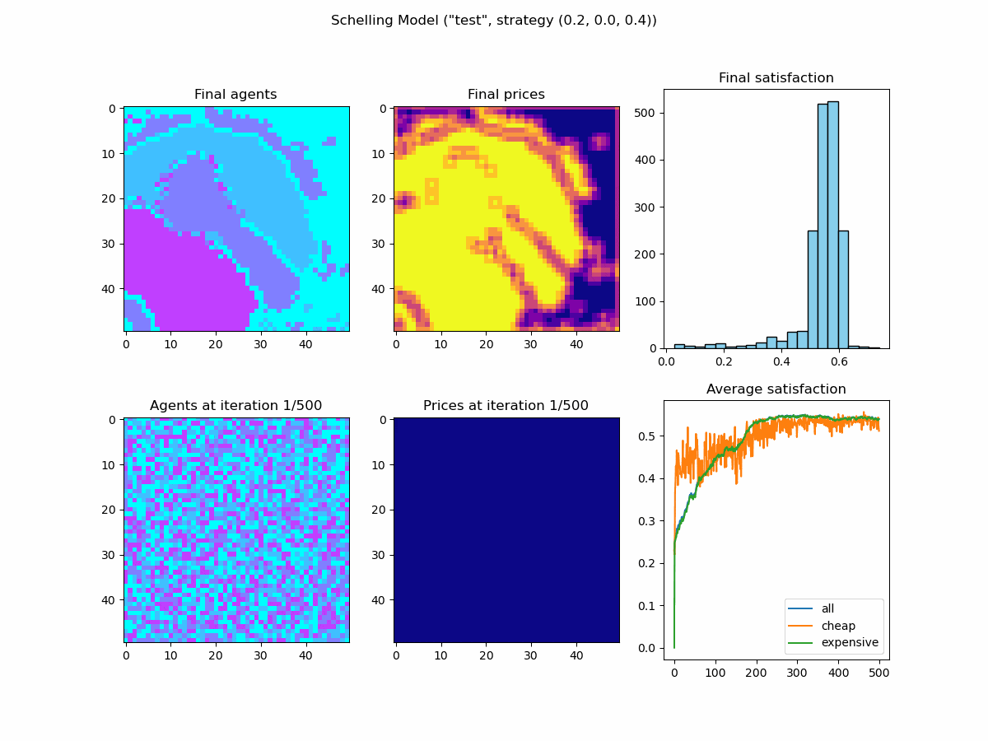
Results - Distance with Noise
Higher demand near center causes outer cells to converge first

Slide 18
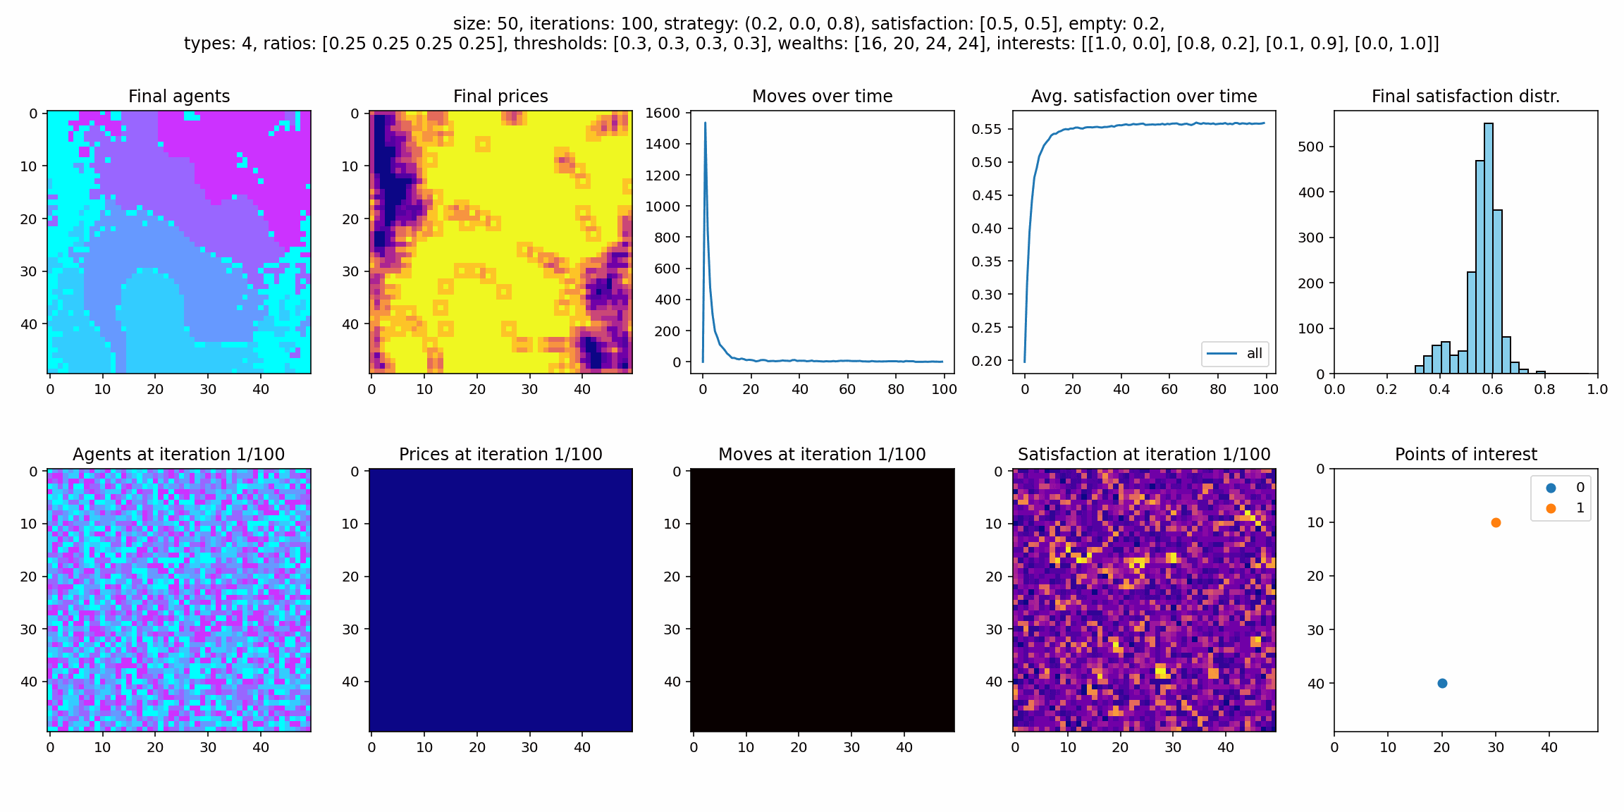
Results - Distance with Multiple Points
Agents sort themselves according to their interests

Slide 19
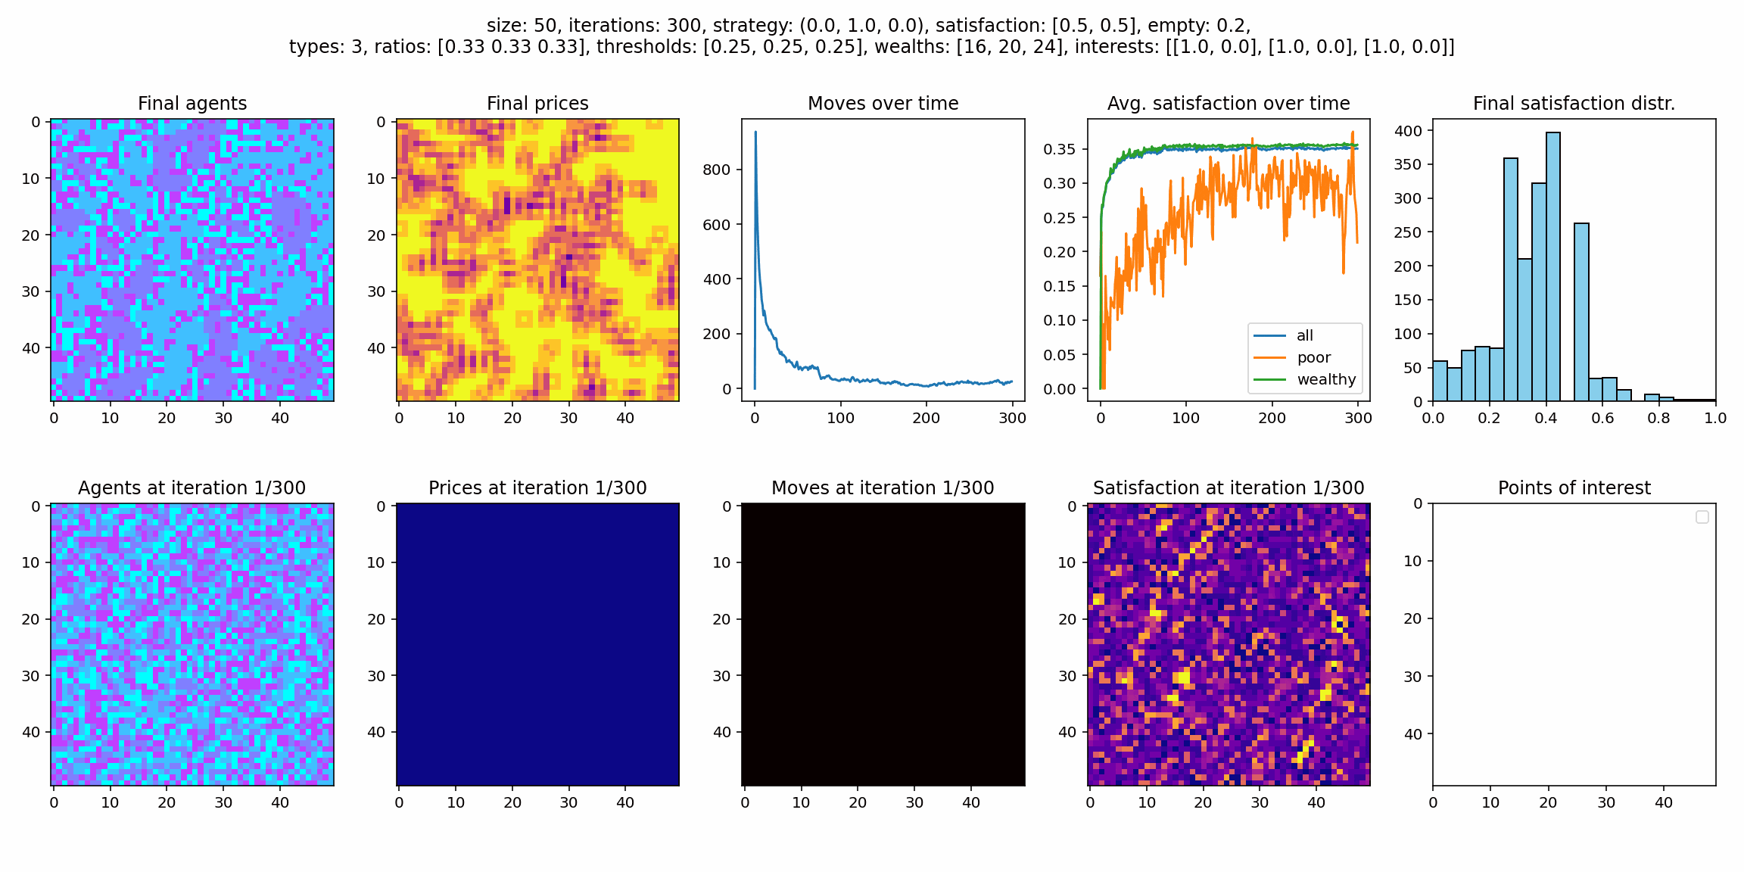
Results - Dynamic Price Strategy
Wealthy agents are easily satisfied while poorer agents move and segregate more

Slide 20
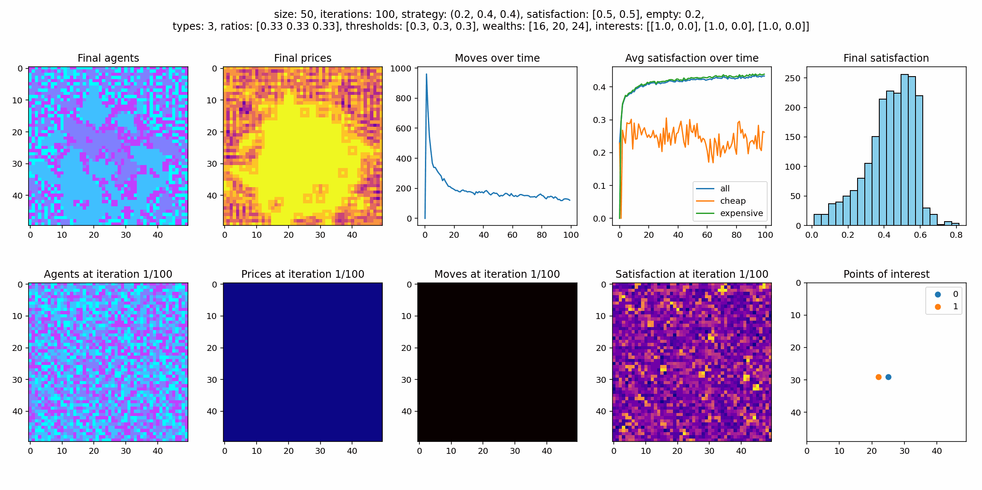
Results - Combined Model
Gentrification: poor people need to move from their cells because of rising prices

Slide 21
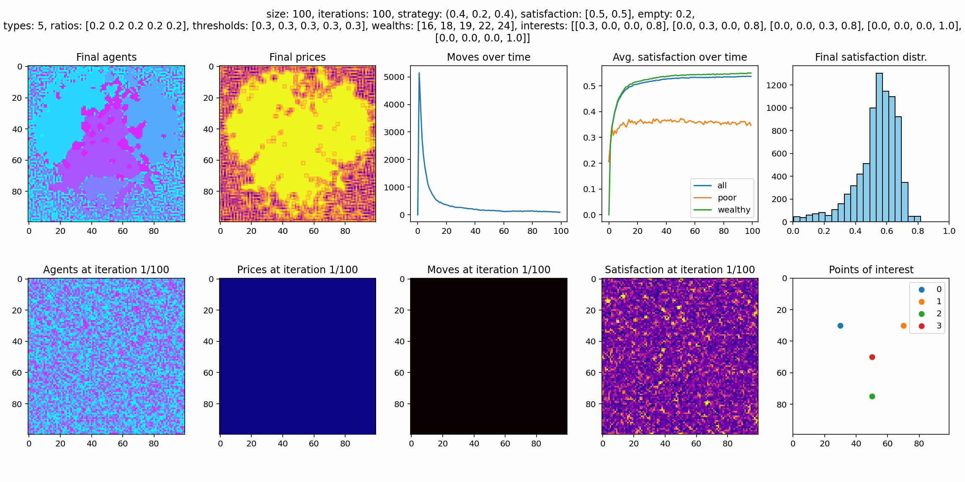
Results - Combined Model
Large model with multiple points and 5 agent types

Slide 22
Discussion
Our model updates the Schelling model of segregation by adding new variables into the agents decision process
The random search process replicates the original Schelling model but with three types of agents
The distance model replicates points of interest in the city, and it could represents parks or plazas, a culinary district or other points of interests
The dynamic price model replicates the city’s rent price system, in which more dense areas are more expensive

Slide 23
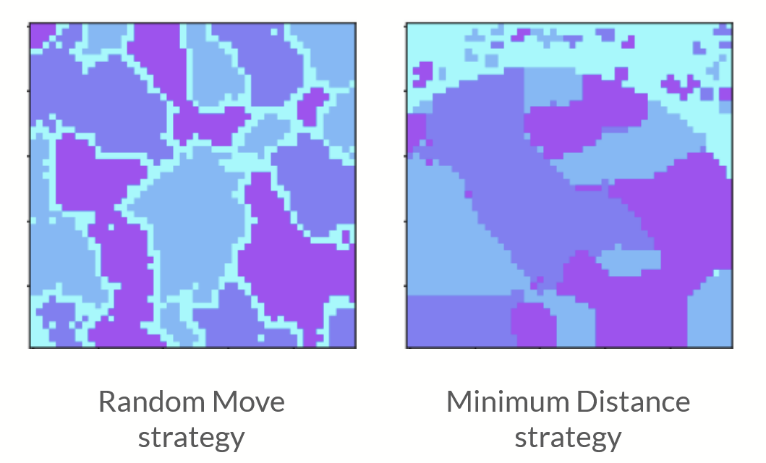
Discussion
Distance model:
This model generates a lower level of segregation, as agents try to get as close as possible to the POI
The generation of POI that are of interest of different groups can generate lower levels of segregation as the interest for a closer location to the venue reduces the empty space.
This result converses with Silver et al. (2021) that showed how urban venues can reduce segregation and shape urban form.

Slide 24
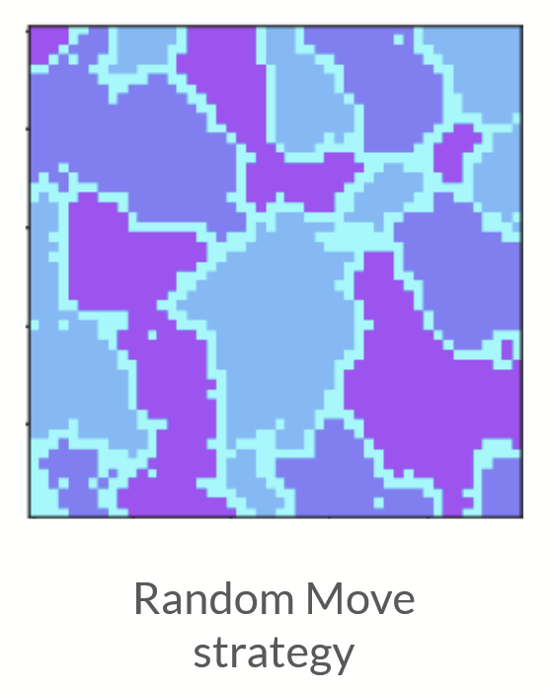
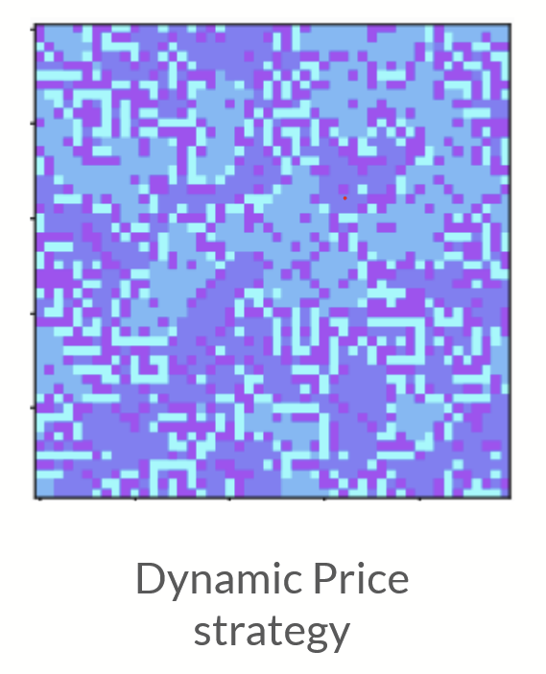
Discussion
Dynamic price model:
Wealthier individuals easily find a satisfactory place, while poor individuals constantly change without arriving to a steady state.
This generates lower segregation than the random model, as agents do not find an affordable place.
Notes:
The urban poor are forced to live in heterogeneous and low dense areas

Slide 25
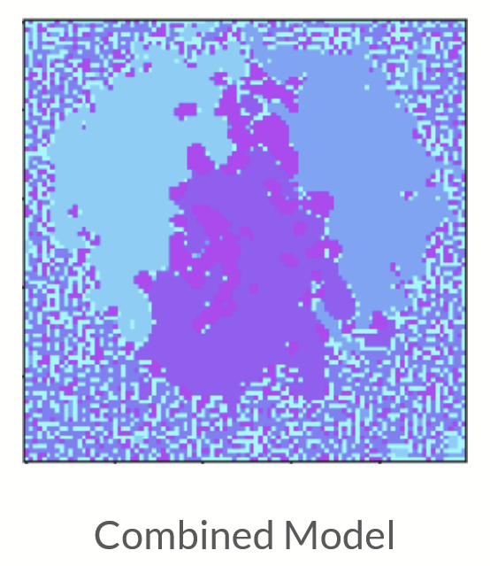
Discussion
Combined model:
Including both characteristics into the generates gentrification effects, as individuals prefer to live in more dense areas, the lower-income individuals are forced to move to further areas, generating impoverished suburbs.
But it solves the problem of lower income individual not finding a satisfactory location.
This model shows that some policies that improve the city can have negative effects in the neighbourhoods, as individuals that are previously living there can be displaced by price increases.
Notes:
The urban poor are forced to live in heterogeneous and low dense areas

Slide 26
References
N. Holden and S. Sheffield, “Scaling limits of the Schelling model” Probability Theory and Related Fields, 2020.
D. Harvey, “The right to the city” New Left Review, London, 2008.
H. Dadashpoor and M. Ghazaie, “Exploring the consequences of segregation through residents’ experiences: Evidence of a neighborhood in Tehran metropolis” Cities, vol 95, 2019.
E. Hatna and I. Benenson, “Combining segregation and integration: Schelling model dynamics for heterogeneous population” Journal of Artificial Societies and Social Simulation, vol. 18, 2015.
Y. Xie and X. Zhou, “Modelling individual-level heterogeneity in racial residential segregation” Proceedings of the National Academy of Sciences, vol. 109, 2012.
E. Bruch and R.Mare “Neighborhood choice and neighborhood change” American Journal of Sociology, vol. 112, 2006
I. Benenson and E. Hatna, “Minority-Majority Relations in the Schelling Model of Residential Dynamics” Geographical Analysis, vol. 43, 2011.
T. Schelling, “Micromotives and Macrobehavior” 1978.
D. Silver, U. Byrne and P. Adler, “Venues and segregation: A revised Schelling Model” PLOS One, 2021.

